Slide 1
Deep Learning
Sequence-to-sequence and Neural Machine Translation

Slide 2
Machine Translation (MT)
Goal: Translate text from one language to the other
Both Language Understanding and Language Generation

Slide 3
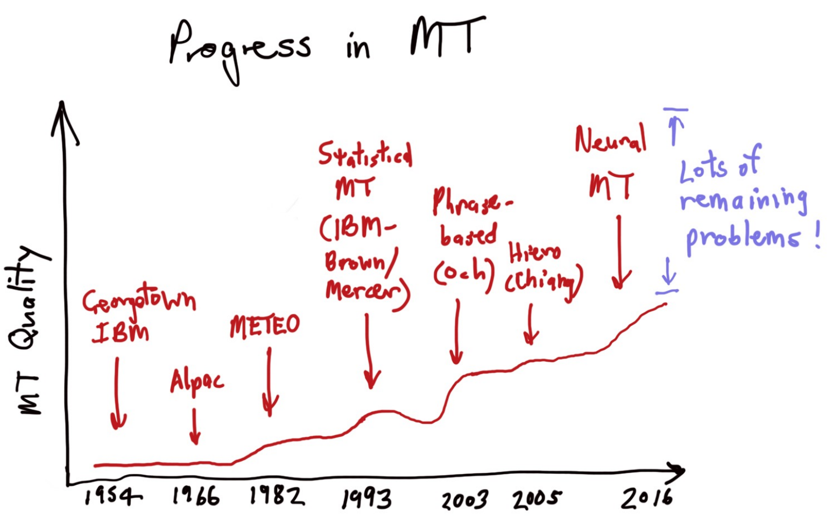
Progress in Machine Translation
https://nlp.stanford.edu/projects/nmt/Luong-Cho-Manning-NMT-ACL2016-v4.pdf

Slide 4
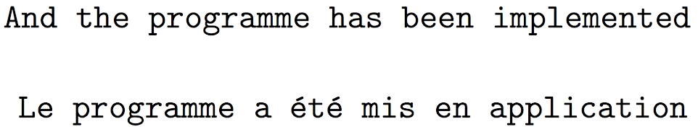
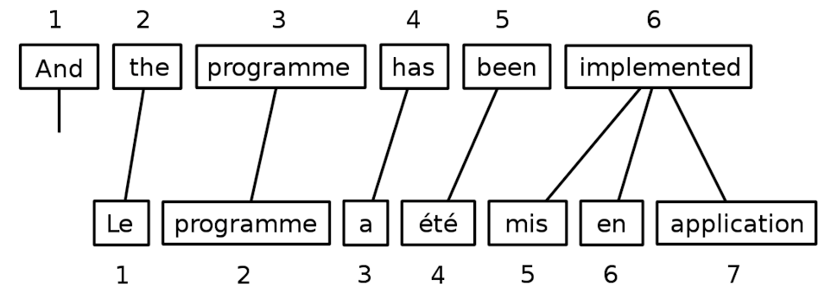
Statistical Machine Translation
Rise in early 90s
Exploit Parallel Text
Word alignment
Slide credit to Karl Stratos

Slide 5
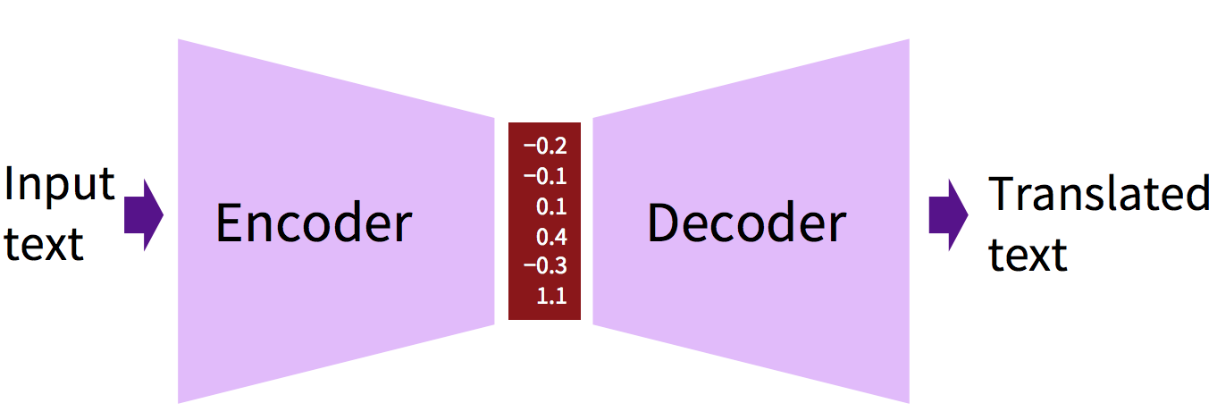
Neural Machine Translation
Modeling the machine translation using neural networks
Encoder for language understanding in source language
Decoder for language generation in target language
https://nlp.stanford.edu/projects/nmt/Luong-Cho-Manning-NMT-ACL2016-v4.pdf

Slide 6
RNN as Encoder and Decoder
MT is essentially a task in which some structured input gets converted to a structured output
A Recurrent Neural Network, or RNN, is a network that operates on a sequence and uses its own output as input for subsequent steps.
A sequence-to-sequence network, or Encoder Decoder network, is a model consisting of two RNNs called the encoder and the decoder.
The encoder reads an input sequence and outputs vectors, and the decoder reads encoder outputs as input to produce an output sequence.
Slide from Rui Zhang

Slide 7
Sequence to Sequence Model
Sutskever, Le, and Vinyals 2014

Slide 8
Sequence to Sequence Model
Sutskever, Le, and Vinyals 2014

Slide 9
Sequence to Sequence Model
Sutskever, Le, and Vinyals 2014

Slide 10
Sequence to Sequence Model
Sutskever, Le, and Vinyals 2014

Slide 11
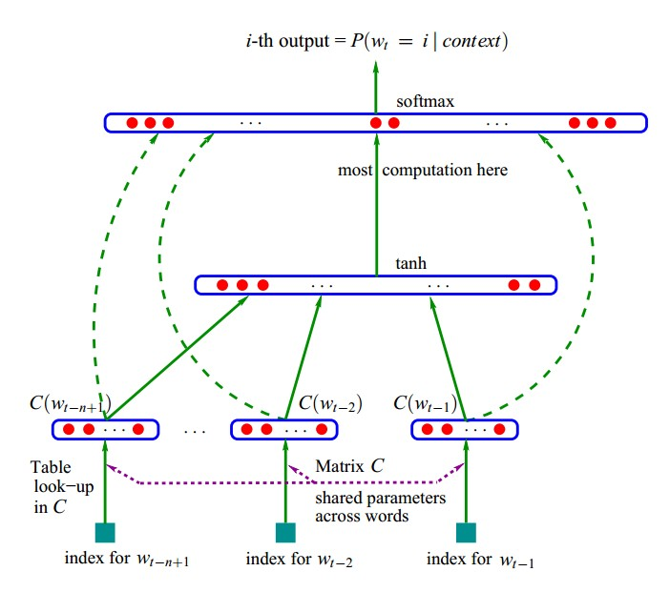
From Language Modeling to MT
[Bengio et al. JMLR 2003]

Slide 12
Multilingual Embeddings
[Hermann and Blunsom 2013: https://arxiv.org/abs/1312.6173]

Slide 13
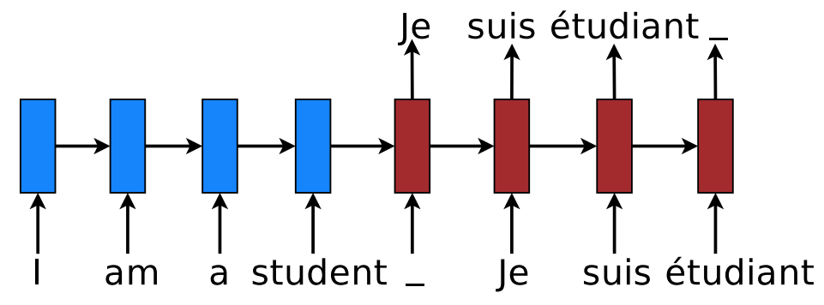
Use RNNs as Encoder and Decoder
https://nlp.stanford.edu/pubs/luong2016iclr_multi.pdf

Slide 14
[Koehn 2017]

Slide 15
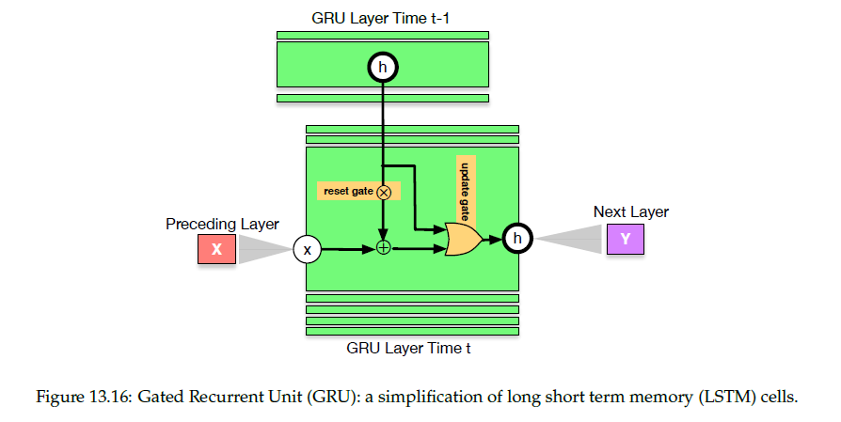
[Koehn 2017]

Slide 16
[Koehn 2017]

Slide 17
[Koehn 2017]

Slide 19
[Koehn 2017]

Slide 20
Beam Decoding
[Koehn 2017]

Slide 21
Beam Decoding
[Koehn 2017]

Slide 22
Domain Transfer
[Koehn 2017]

Slide 23
[Koehn 2017]

Slide 24
[Koehn 2017]

Slide 25
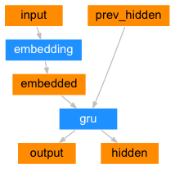
GRU Encoder
For every input word in the sentence, it is first used to index a word embedding matrix to get its embedding.
Then the encoder produces an output vector and a hidden state from the word embedding and the previous hidden state.
The hidden state is used for the next input word.
The initial hidden state is initialized as a zero vector.

Slide 26
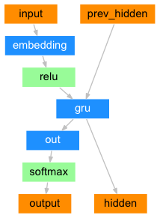
GRU Decoder
The decoder is another RNN that outputs a sequence of words.
The simple decoder uses only the last output of the encoder, which is called context vector.
At each step, the decoder takes an input word and the previous hidden state.
At the very beginning, the input token is the start-of-sentence<SOS>token, and the hidden state is the context vector encoding the meaning of the source sentence.
Then the decoder will work as illustrated below to produce an output vector and a hidden state for next step.
The output vector is a probability distribution over the target language vocabulary.

Slide 27
Adding Attention to the Decoder
The simple decoder takes the final hidden state of the encoder and uses that to decode the target sentence. This requires to encode the entire sentence into a single fixed-size vector, which is difficult.
To solve this, we use the attention mechanism such that all the hidden states of the encoder are used to decode the target sentence.

Slide 28
Attention Illustration
At each step of decoding, the decoder attention focuses on different parts of the input sentence.
[Bahdanau, Cho, Bengio ICLR 2015]

Slide 29
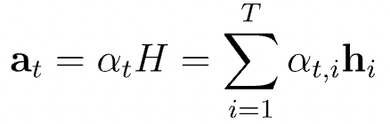
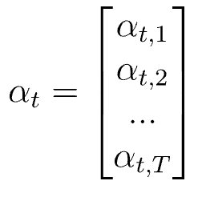
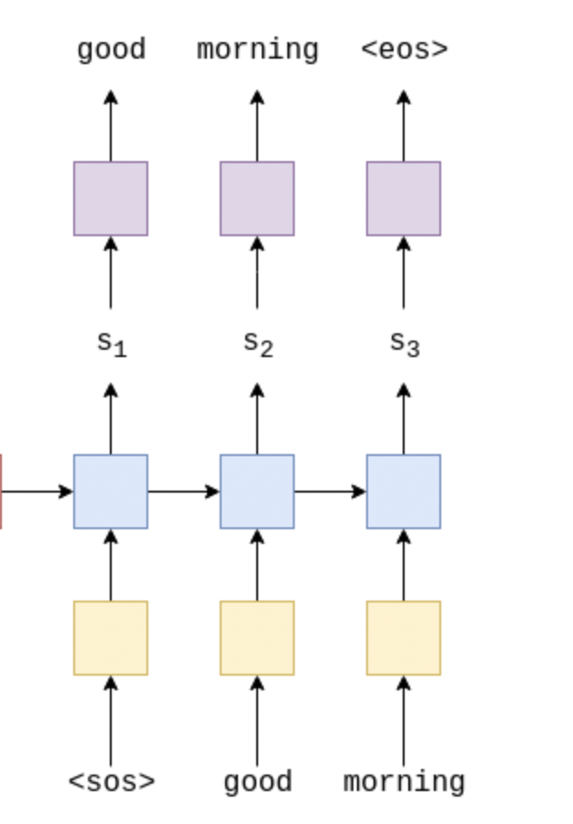
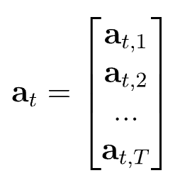
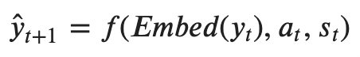
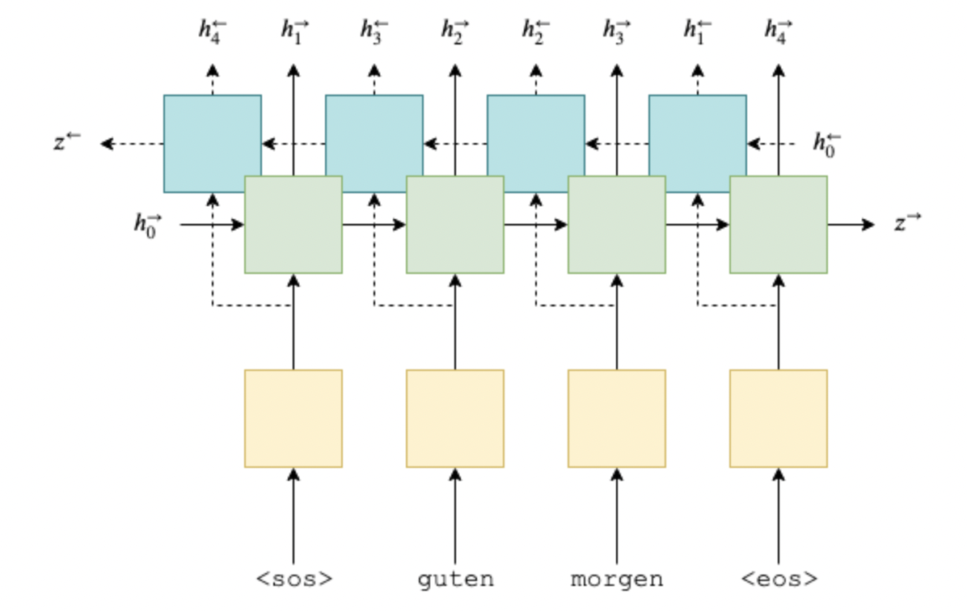
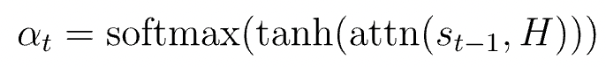
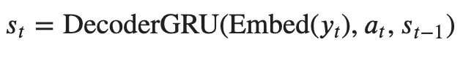
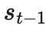
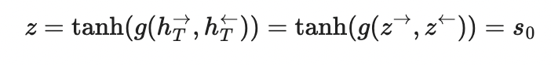

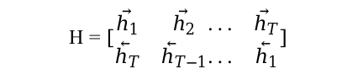
Attention mechanism
Attention score at
decoder time step t
Encoder
Decoder
weighted sum
Encoder outputs
Attention vector at
decoder time step t
$$H=\left[\begin{matrix}{\vec{h}}_{1} & {\vec{h}}_{2} \\ {\overset{⃖}{h}}_{T} & {\overset{⃖}{h}}_{T−1}\end{matrix}\begin{matrix}... & {\vec{h}}_{T} \\ ... & {\overset{⃖}{h}}_{1}\end{matrix}\right]$$
Output layer
Attention layer
bidirectional
RNN layer
unidirectional
RNN layer
linear layer + tanh
Embedding layer
Embedding layer
$$⨁$$
z
context vector
y_{t} (good) input token at time step t

Slide 30
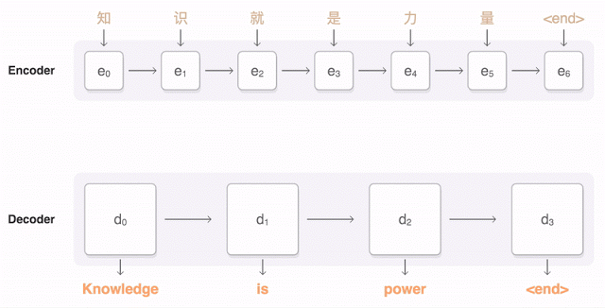
Google Neural Translation System
https://research.googleblog.com/2016/09/a-neural-network-for-machine.html

Slide 31
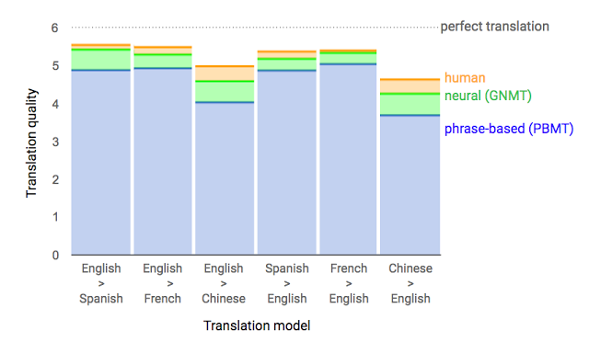
Google Neural Translation System
https://research.googleblog.com/2016/09/a-neural-network-for-machine.html

Slide 32
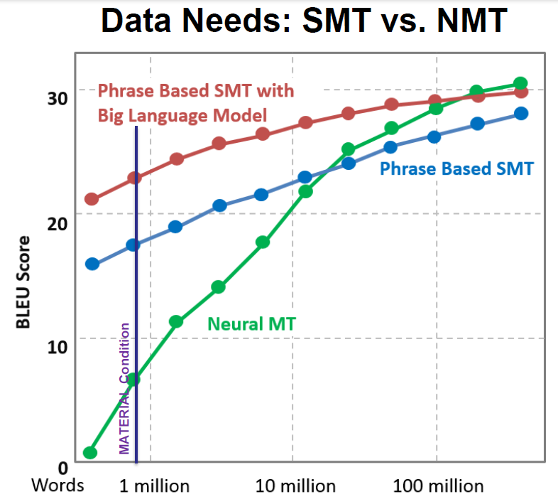
Data Needs: SMT vs. NMT
Slide from Philipp Koehn

Slide 33
Software/Code in Homework5 - NMT
Data Processing
Read normalize, filter sentence pairs
prepare_data.py
PyTorch
Build, Train, Evaluate NMT model
run_nmt.py, network.py
Matplotlib
Plot Attention produced by NMT model
Plot.py
BLEU evaluator
Calcualte BLEU scores given system outputs and gold standard sentences
Bleu.py

